Slide 1
2
DERIVATIVES

Slide 2
DERIVATIVES
2.1
Derivatives and
Rates of Change
In this section, we will learn:
How the derivative can be interpreted as a rate
of change in any of the sciences or engineering.
Notes:
The slope of tangent line as the limit of slopes of secant lines
Physical examples of instantaneous rates of change and their unit.
The derivative notation f’(a) and meaning of its.
Using f’ to write an equation of the tangent line to a curve at a given point.
Using f’ as an approximate rate of change when working with discrete data.

Slide 3
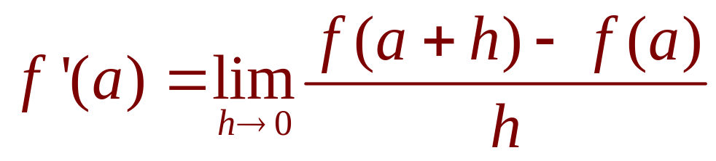
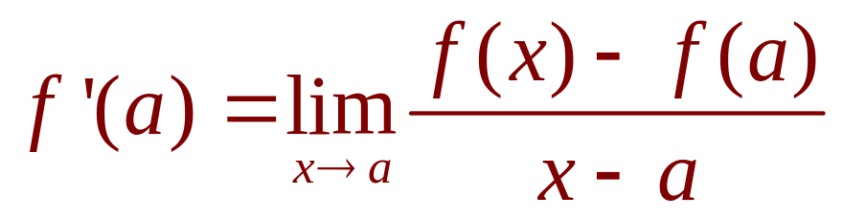
DERIVATIVES
4. Definition
The derivative of a function f at a number a, denoted by f’(a), is:
if this limit exists. Or
Notes:
Meaning of f’(a)?

Slide 4
DERIVATIVES
2.2
The Derivative as a Function
In this section, we will learn about:
The derivative of a function f.
Notes:
The concept of a differentiable function interpreted graphically, algebraically and descriptive.
Obtaining the derivative function f’ by first considering the derivative at a point a and then a:= a variable such as x.
How a function can fail to be differentiable.
Second and higher derivatives.

Slide 5

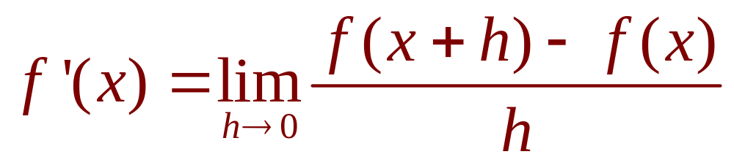
DERIVATIVES
1. Equation
In the preceding section, we considered the derivative of a function f at a fixed number a:
If we replace a in Equation 1 by a variable x, we obtain:
Notes:
f‘(a) is a number; f’(x) is a function

Slide 6
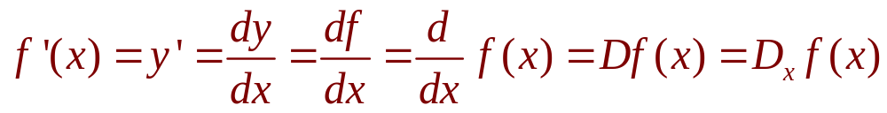
OTHER NOTATIONS
Some common alternative notations for the derivative are as follows:
The symbols D and d/dx are called differentiation operators.
The symbol dy/dx is called Leibniz notation

Slide 7
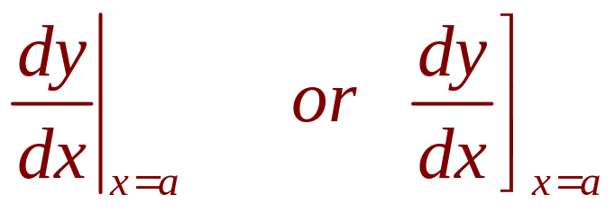
OTHER NOTATIONS
If we want to indicate the value of a derivative dy/dx in Leibniz notation at a specific number a, we use the notation
which is a synonym for f’(a).

Slide 8
OTHER NOTATIONS
3. Definition
A function f is differentiable at a if f’(a) exists.
It is differentiable on an open interval D if it is differentiable at every number in the interval D.

Slide 9
HOW CAN A FUNCTION FAIL TO BE DIFFERENTIABLE?
Theorem
If f is differentiable at a,
then f is continuous at a.
This theorem states that, if f is not continuous at a, then f is not differentiable at a.
Notes:
“<=“ is false: y = |x| is continuous at 0 but it is not differentiable at 0.

Slide 10
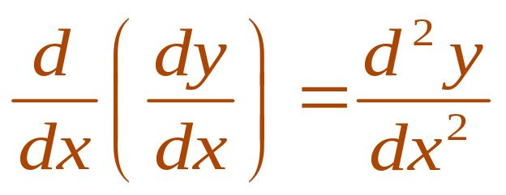
HIGHER DERIVATIVES
If f is a differentiable function, then its derivative f’ is also a function.
So, f’ may have a derivative of its own, denoted by
(f’)’= f’’.
This new function f’’ is called the second derivative of f.

Slide 11
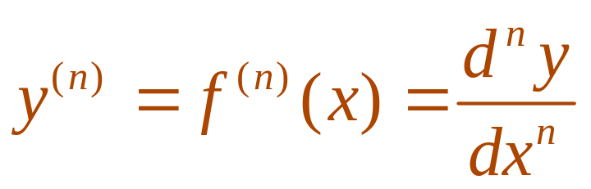
HIGHER DERIVATIVES
The process can be continued.
  In general, the nth derivative of f is denoted by f^{(n)} and is obtained from f by differentiating n times.
  If y = f(x), we write:

Slide 12
DERIVATIVES
2.3,4,5,6
Differentiation Formulas
In this section, we will learn:
How to differentiate constant functions,
power functions, polynomials, and
exponential functions.
Notes:
The computation of derivatives using the power, constant multiple, sum, difference, product and quotient rules.
The normal line to a curve at a point.

Slide 13
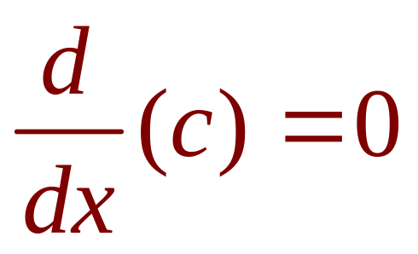
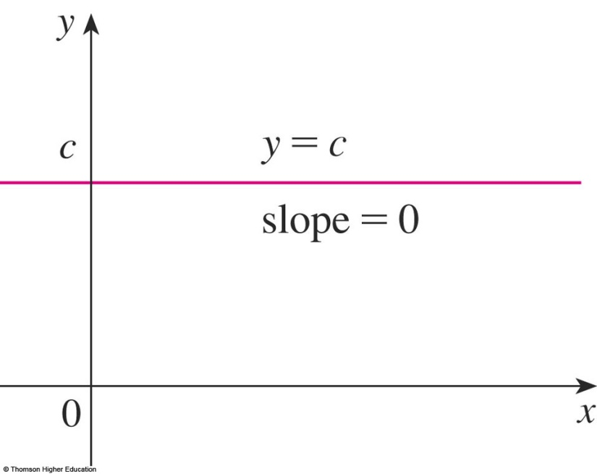
CONSTANT FUNCTION—DERIVATIVE
In Leibniz notation, we write this rule as follows.
(Reference Pages, p.5)
Notes:
e is constant

Slide 14
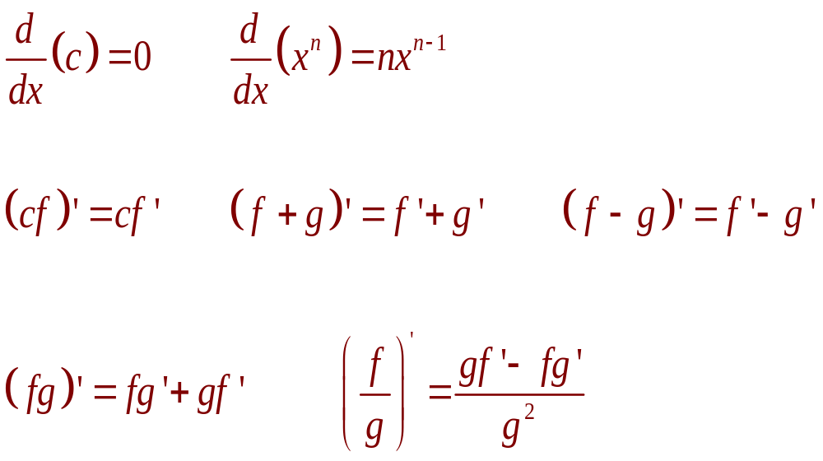
DIFFERENTIATION FORMULAS
Here’s a summary of the differentiation formulas we have learned so far.

Slide 15

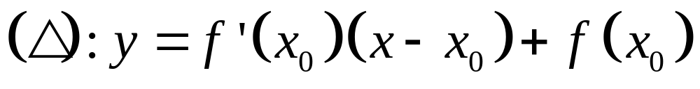
Tangent line (Δ) equation at M(x₀,y₀) (C): y = f(x)

Slide 16
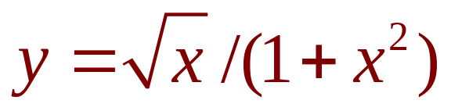
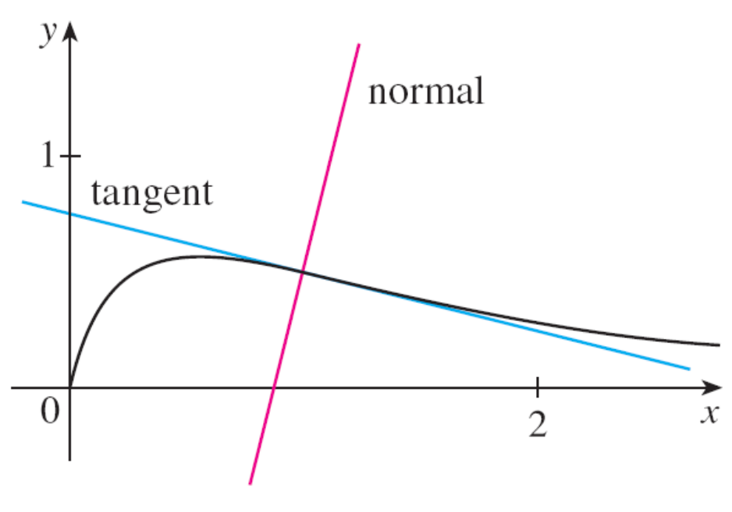
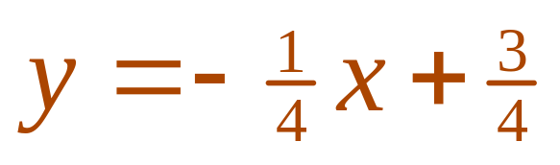
TANGENT AND NORMAL LINES
Example 12
Find equations of the tangent line and normal line to the curve
at the point (1, ½).
© Thomson Higher Education
Notes:
The normal line is defined as the line that is perpendicular to the tangent line at the point of tangency.

Slide 17
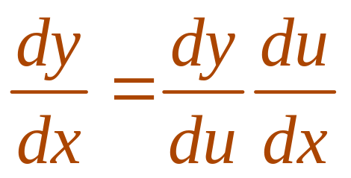
THE CHAIN RULE
If g is differentiable at x and f is differentiable at g(x), the composite function h = f ◦ g is differentiable at x and F’ is given by the product:
h’(x) = f’(g(x)) • g’(x)
  In Leibniz notation, if y = f(u) and u = g(x) are both differentiable functions, then:
Notes:
dy/dx is y’ dependent on x
dy/du is y’ dependent on u
du/dx is u’ dependent on x
“/” is not division.

Slide 18
Let f(x)=g(sin3x). Find f’ in terms of g’.
A | 3cos3xg’(x)
B | 3cos3xg’(sin3x)
C | cos3xg’(sin3x)
Answer: b

Slide 19
Suppose h(x)=f(g(x)) and f(2)=3, g(2)=1, g’(2)=1, f’(2)=2, f’(1)=5. Find h’(2).
A | 1
B | 2
C | 3
D | 4
E | 5
Answer: e

Slide 20
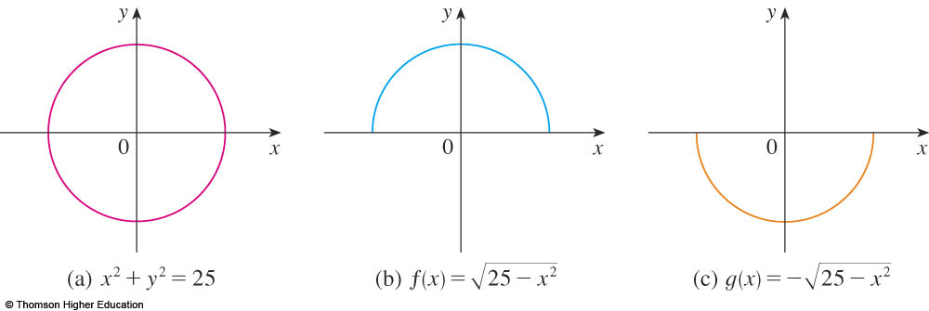
IMPLICIT DIFFERENTIATION
The graphs of f and g are the upper and lower semicircles of the circle
x² + y² = 25.
Notes:
What is implicit function?
The technique of implicit differentiation

Slide 21
IMPLICIT DIFFERENTIATION METHOD
Instead, we can use the method of implicit differentiation.
  This consists of differentiating both sides of the equation with respect to x and then solving the resulting equation for y’.

Slide 22
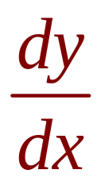
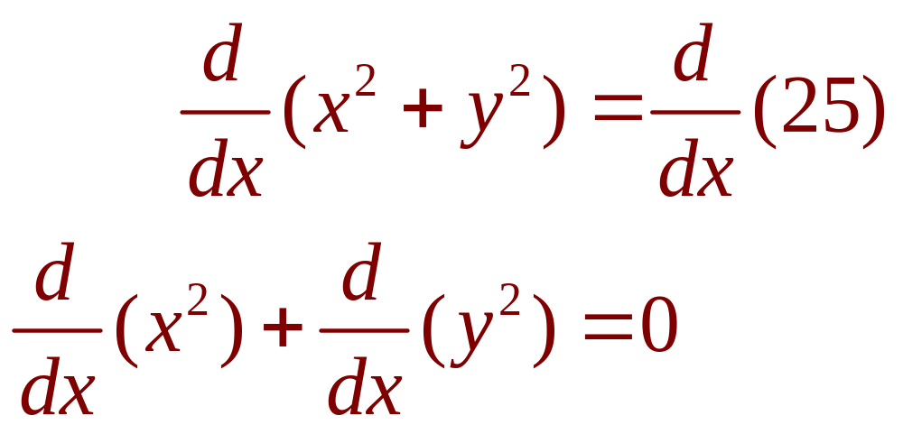
IMPLICIT DIFFERENTIATION
Example 1
a. If x² + y² = 25, find .
b. Find an equation of the tangent to the circle x² + y² = 25 at the point (3, 4).

Slide 23
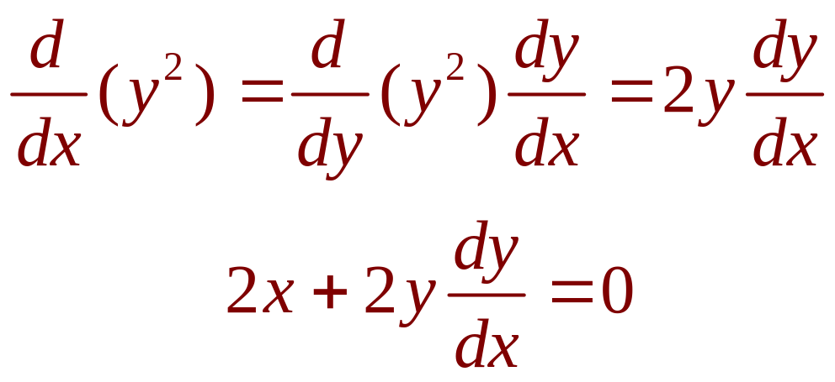
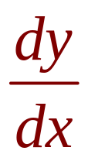
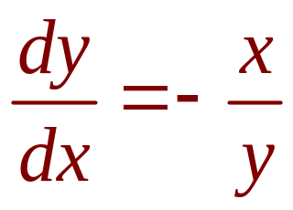
IMPLICIT DIFFERENTIATION
Example 1 a
Remembering that y is a function of x and using the Chain Rule, we have:
Then, we solve this equation for :

Slide 24
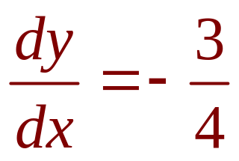
IMPLICIT DIFFERENTIATION
E. g. 1 b—Solution 1
At the point (3, 4) we have x = 3 and y = 4.
So,
  Thus, an equation of the tangent to the circle at (3, 4)
  is: y – 4 = – ¾(x – 3) or 3x + 4y = 25.

Slide 25
IMPLICIT DIFFERENTIATION
Example 4
Find y” if x⁴ + y⁴ = 16.
Differentiating the equation implicitly with respect to x, we get 4x³ + 4y³y’ = 0.

Slide 26
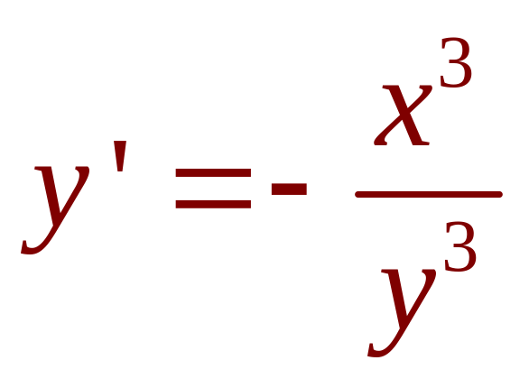
IMPLICIT DIFFERENTIATION
E. g. 4—Equation 3
Solving for y’ gives:

Slide 27
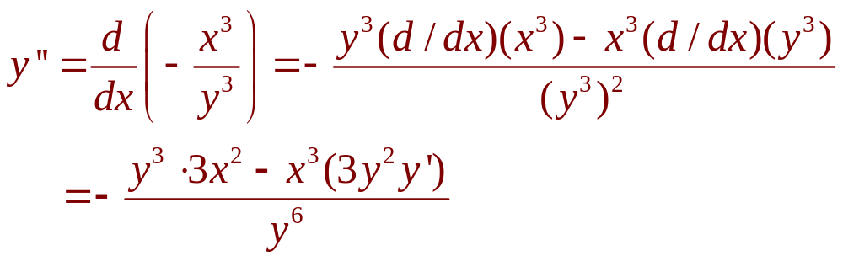
IMPLICIT DIFFERENTIATION
Example 4
To find y’’, we differentiate this expression
for y’ using the Quotient Rule and remembering that y is a function of x:

Slide 28
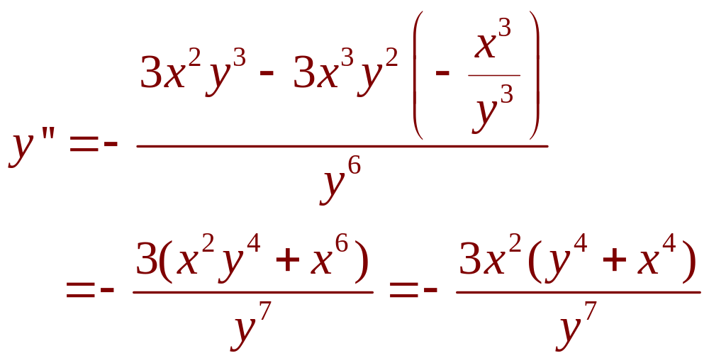
IMPLICIT DIFFERENTIATION
Example 4
If we now substitute Equation 3 into
this expression, we get:

Slide 29
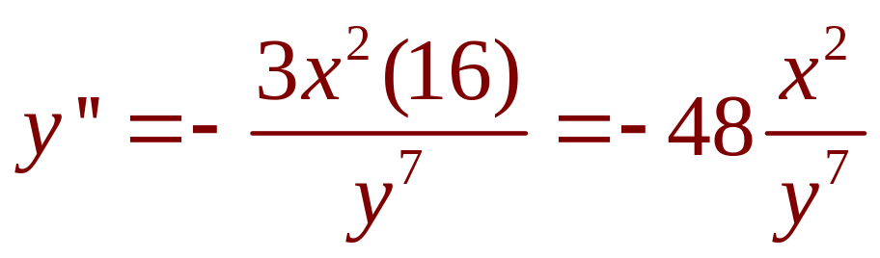
IMPLICIT DIFFERENTIATION
Example 4
However, the values of x and y must satisfy the original equation x⁴ + y⁴ = 16.
So, the answer simplifies to:

Slide 30
DERIVATIVES
2.7
Related Rates
In this section, we will learn:
How to compute the rate of change of one quantity
in terms of that of another quantity.
Notes:
Bài tập:
2.6: 6, 10, 16, 18, 25
2.5: 2, 6, 9, 39, 48

Slide 31
STRATEGY
It is useful to recall some of the problem-solving principles from Chapter 1 and adapt them to related rates in light of our experience in Examples 1–3.
  Read the problem carefully.
  Draw a diagram if possible.
  Introduce notation. Assign symbols to all quantities that are functions of time.
  (…, p.129)

Slide 32
RELATED RATES
Example 1
Air is being pumped into a spherical balloon so that its volume increases at a rate of
100 cm³/s.
How fast is the radius of the balloon increasing when the diameter is 50 cm?
Notes:
List quantities: V, r, t
V in terms of r and t
r in terms of t.

Slide 33
Example 1
The key thing to remember is that rates of change are derivatives.
  In this problem, the volume and the radius are
  both functions of the time t.
  The rate of increase of the volume with respect
  to time is the derivative dV / dt.
  The rate of increase of the radius is dr / dt.

Slide 34
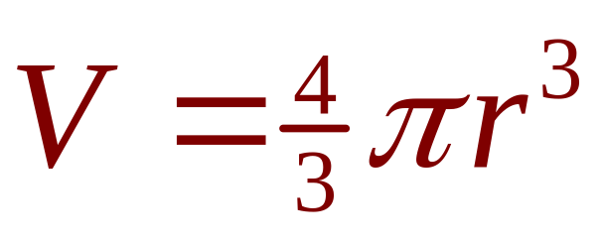
RELATED RATES
Example 1
To connect dV/dt and dr/dt, first
we relate V and r by the formula for
the volume of a sphere:

Slide 35
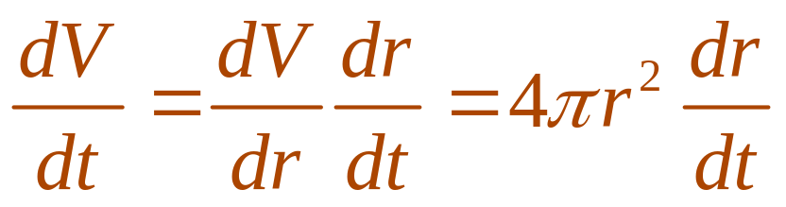
Example 1
To use the given information, we differentiate each side of the equation with respect to t.
  To differentiate the right side, we need to use
  the Chain Rule:

Slide 36
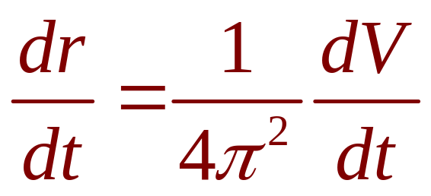
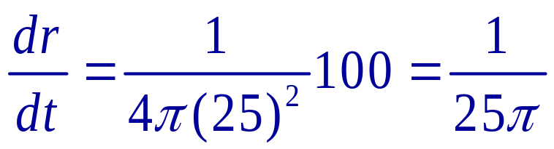
RELATED RATES
Example 1
Now, we solve for the unknown quantity:
  If we put r = 25 and dV / dt = 100 in this equation,
  we obtain:
  The radius of the balloon is increasing at the rate
  of 1/(25π) ≈ 0.0127 cm/s.

Slide 37
Example 2
A ladder 10 ft long rests against a vertical wall.
If the bottom of the ladder slides away
from the wall at a rate of 1 ft/s, how fast is
the top of the ladder sliding down the wall when the bottom of the ladder is 6 ft from
the wall?

Slide 38
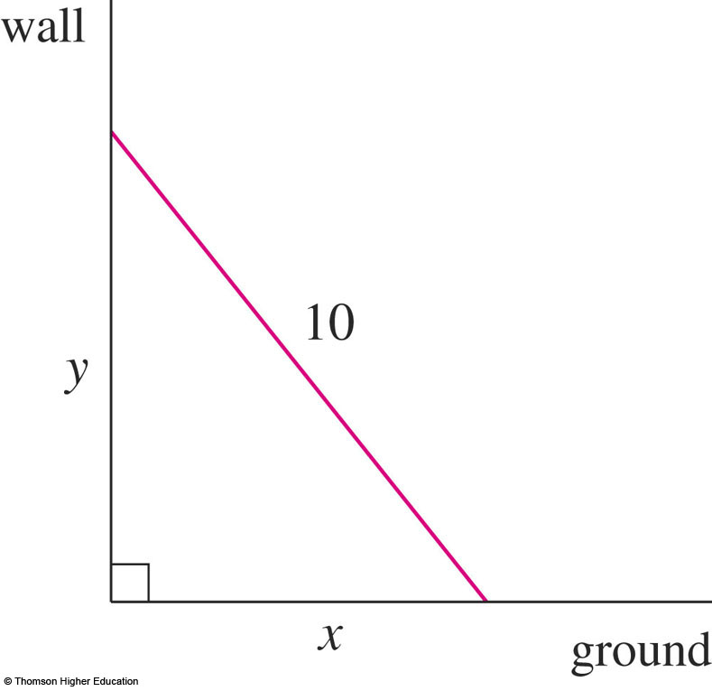
Example 2
We first draw a diagram and label it
as in the figure.
  Let x feet be the distance from the bottom of the ladder to the wall and y feet the distance from the top of the ladder to the ground.
  Note that x and y are
  both functions of t
  (time, measured in
  seconds).

Slide 39
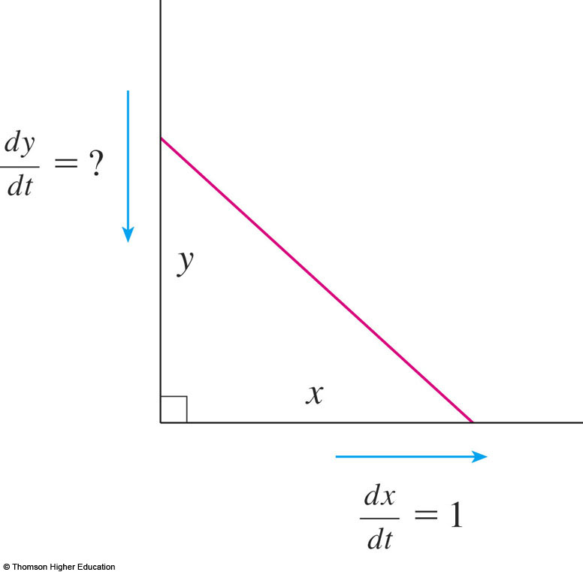
Example 2
We are given that dx / dt = 1 ft/s
and we are asked to find dy / dt
when x = 6 ft.

Slide 40
Example 2
In this problem, the relationship between
x and y is given by the Pythagorean Theorem: x² + y² = 100

Slide 41
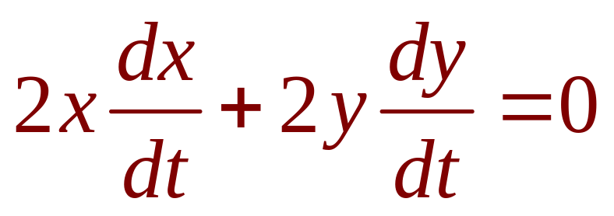
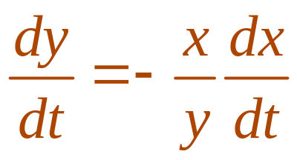
Example 2
Differentiating each side with respect to t using the Chain Rule, we have:
  Solving this equation for the desired rate,
  we obtain:

Slide 42
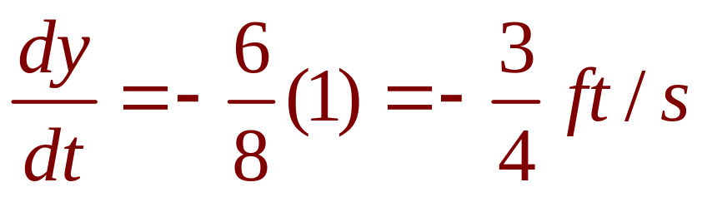
Example 2
When x = 6 , the Pythagorean Theorem gives y = 8 and so, substituting these values and
dx / dt = 1, we have:
  The fact that dy / dt is negative means that
  the distance from the top of the ladder to
  the ground is decreasing at a rate of ¾ ft/s.
  That is, the top of the ladder is sliding down
  the wall at a rate of ¾ ft/s.

Slide 43
DERIVATIVES
2.8
Linear Approximations
and Differentials
In this section, we will learn about:
Linear approximations and differentials
and their applications.
Notes:
The general equation of a line tangent to the graph of a function, and its use in approximating that function near a point.
The differential as the difference between the linearization of a function and that function.

Slide 44
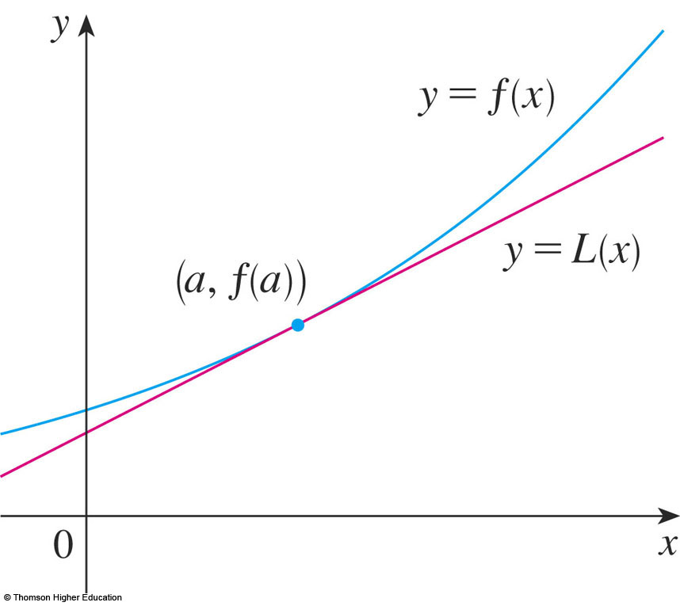
LINEAR APPROXIMATIONS
We use the tangent line at (a, f(a)) as an approximation to the curve y = f(x) when x is near a.
  An equation of
  this tangent line is
  L(x) = y = f(a) + f’(a)(x - a)

Slide 45
LINEAR APPROXIMATION
Equation 1
The approximation
f(x) ≈ f(a) + f’(a)(x – a) = L(x)
is called the linear approximation of f at a.

Slide 46
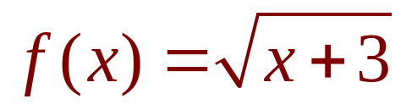
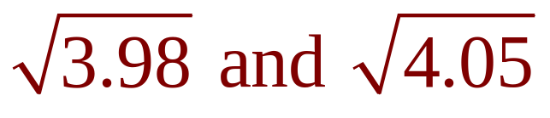
LINEAR APPROXIMATIONS
Example 1
Find the linearization of the function
at a = 1 and use it to approximate the numbers
Are these approximations overestimates or underestimates?
Notes:
select the appropriate function, in this case such that f(x) = x^{1/2}

Slide 47
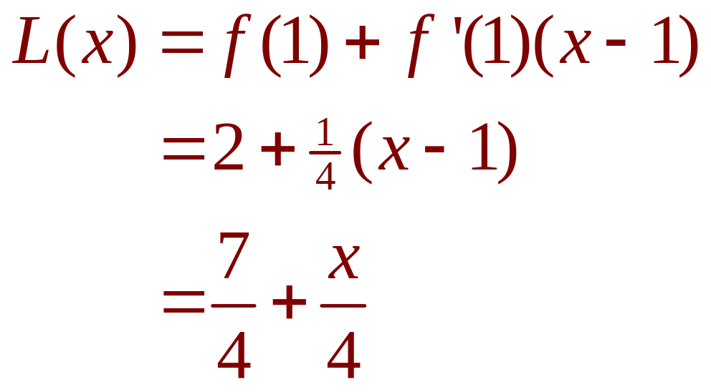
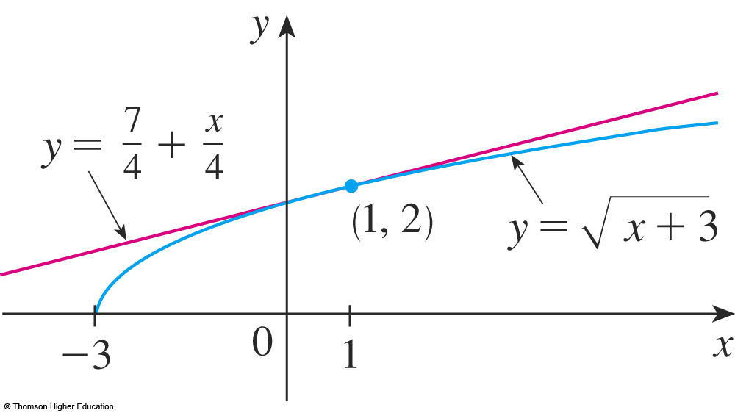
LINEAR APPROXIMATIONS
Example 1
Putting these values into Equation 2, we see that the linearization is:

Slide 48
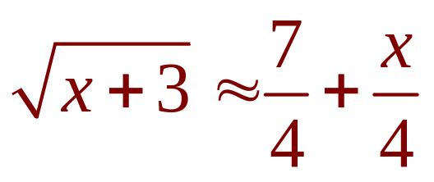
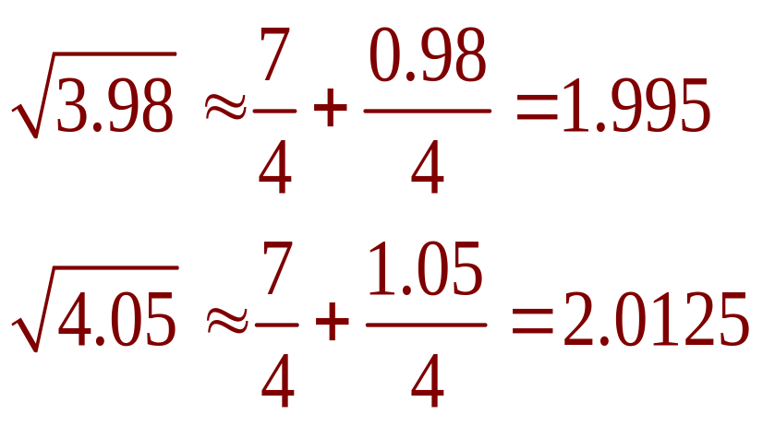
LINEAR APPROXIMATIONS
Example 1
The corresponding linear approximation is:
(when x is near 1)
In particular, we have:

Slide 49
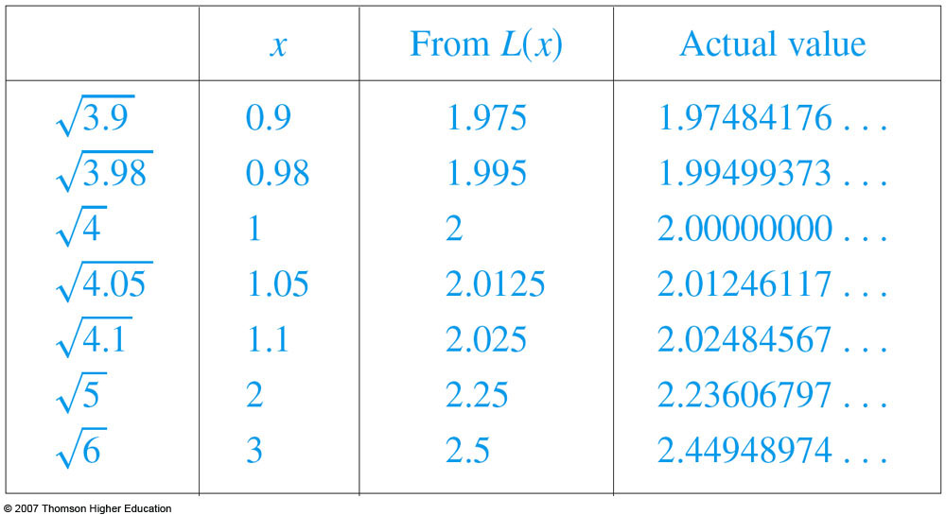
LINEAR APPROXIMATIONS
Look at the table and the figure.
  The tangent line
  approximation
  gives good
  estimates if x
  is close to 1.
  However,
  the accuracy decreases
  when x is farther away from 1.

Slide 50
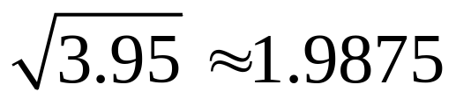
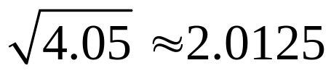
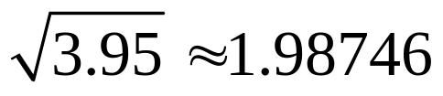
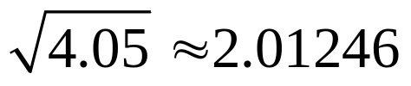
Use the linear approximation to of the function at
a=3 to approximate the numbers. Select the correct ones.
a) b)
c) d)
Answer: a and b

Slide 51
DIFFERENTIALS
Example 4
The radius of a sphere was measured
and found to be 21 cm with a possible error
in measurement of at most 0.05 cm.
What is the maximum error in using this
value of the radius to compute the volume
of the sphere?
Notes:
Differential of y=f(x) is dy = f’(x)dx

Slide 52
DIFFERENTIALS
Example 4
If the radius of the sphere is r, then
its volume is V = 4/3πr³.
  If the error in the measured value of r
  is denoted by dr = ∆r, then the corresponding
  error in the calculated value of V is ∆V.

Slide 53
DIFFERENTIALS
Example 4
This can be approximated by the differential
dV = 4πr²dr
When r = 21 and dr = 0.05, this becomes:
dV = 4π(21)² 0.05 ≈ 277
  The maximum error in the calculated volume
  is about 277 cm³.

Slide 54
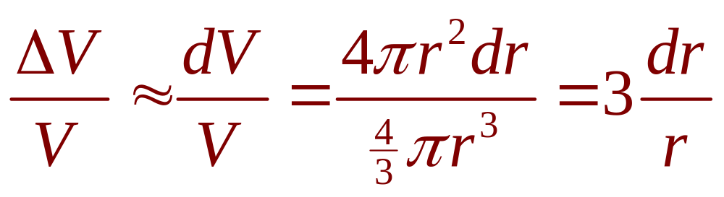
RELATIVE ERROR
Note
Relative error is computed by dividing
the error by the total volume:
  Thus, the relative error in the volume is about
  three times the relative error in the radius.

Slide 55
RELATIVE ERROR
Note
In the example, the relative error in the radius
is approximately dr/r = 0.05/21 ≈ 0.0024
and it produces a relative error of about 0.007 in the volume.
  The errors could also be expressed as
  percentage errors of 0.24% in the radius
  and 0.7% in the volume.

Slide 56
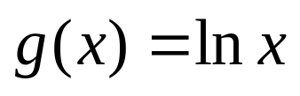
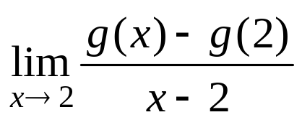
Quiz
Find the limit if
.
a. 1 b. ½ c. 1/3 d. 2
Notes:
This is (lnx)’

Slide 57



Quiz
Find when x=2 if
a. 1 b.2 c.3 d.4 e.0
Notes:
Chain rule

Slide 58
Quiz
The equation of the tangent line to the curve y= x - sin x at (∏, ∏)
is
y=0 b) y=2x c) y=2x-2
d) y=2x+2 e) None of the others
Answer: e

Slide 59
Quizzes
If 1/f =1/u+1/v then du/dv is:
f/(v-f)² b) –f²/(v-f)²
c) 2f²/(v-f)² d)-2f²/(v-f)²
e) None of the others
Answer: b

Slide 60
Thanks

